Slide 1
Indie Platform Game
Research Phase Presentation
Hugh Desmond

Slide 2
Introduction
2D Platformer
Microsoft XBOX 360
XBLIG – Xbox Live Indie Games
C# – Visual Studio with XNA

Slide 3
The Platformer
Characterized by having the player jump to and from suspended platforms or manoeuvre around obstacles
Often Mixed with:
- Puzzle Solving
- Shooting
- Role-Playing Elements

Slide 4
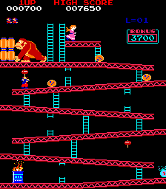
The Platformer – Brief History
Early 80s
Limited Hardware
Single Screen
Jumping & climbing
Chip-tune audio
e.g. Donkey Kong

Slide 5
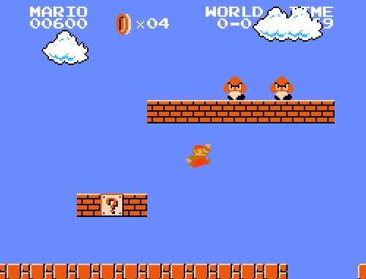
The Platformer – Brief History
Mid 80s
Popular Genre
Transitional
Side-Scrolling
2-Player Platformers
e.g. Super Mario Bros

Slide 6
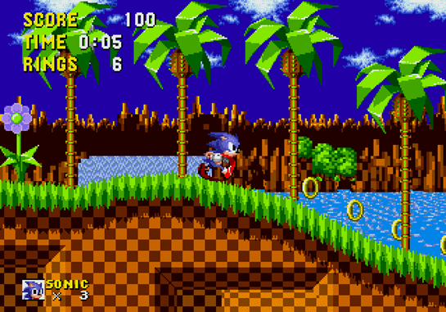
The Platformer – Brief History
Late 80s/Early 90s
Flagship Genre
16-bit
Parallax Backgrounds
Multi-directional Scrolling
Detailed art & sound
e.g. Sonic The Hedgehog

Slide 7

The Platformer – Brief History
Late 90s+
Decline in Popularity
32-bit, 3D games
Vast Environments
Huge Development Teams
Genre Ambiguity
e.g. Ratchet & Clank

Slide 8

Fun Gameplay – The Science
Traced back to basic human needs
Need fulfilled = release of dopamine
4 Experiences present in games (Roger Caillois)
Competition
Chance
Vertigo
Make-believe

Slide 9
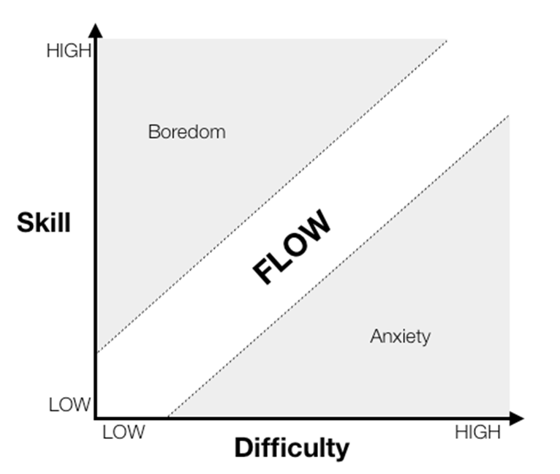
Fun Gameplay – The Science
Key factor in video games is Challange
“Pleasure comes in the area between boredom and anxiety at the distinct moment where our options are in line with our abilities”
State of flow A.K.A. “The Zone”

Slide 10
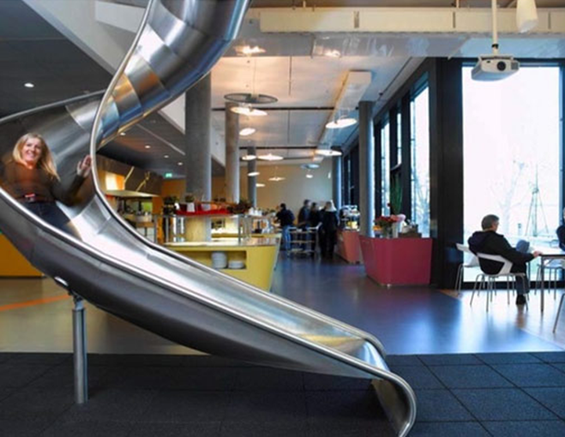
Fun Gameplay – The Science
Popular game mechanics:
- Behavioural Momentum
- Blissful productivity
- Cascading Information
- Discovery
- Time-Constraint
- Loss Aversion

Slide 11
Game Development Approach
Iterative Development
Prototype-Heavy Approach
Feedback-driven => Playtesting

Slide 12
Requirements Specification
Functional Requirements Summary:
- 3 unique levels
- 2 unique weapons
- 2 unique enemies
- 3 or more puzzles
Non-functional:
- Usability & Humanity Requirements
- Design Requirements
- Performance Requirements
- Implementation and Testing Requirements

Slide 13
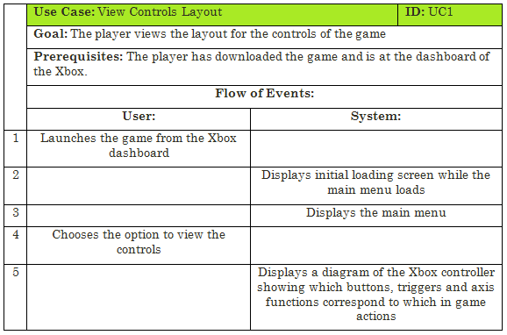
Use Cases

Slide 14
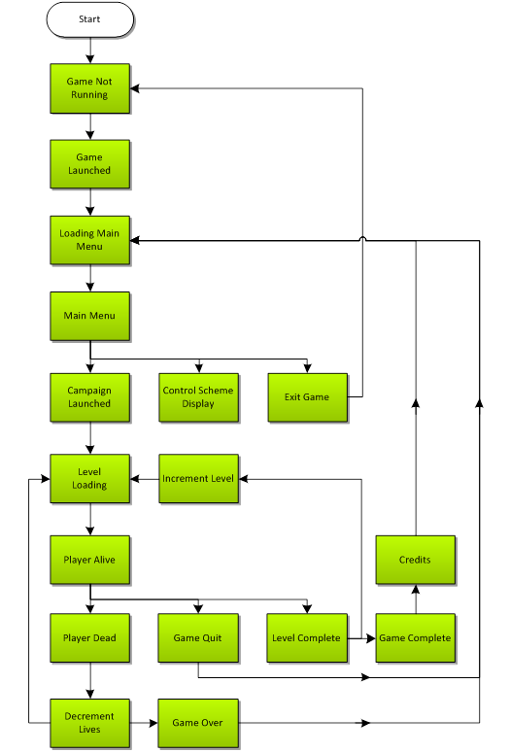
Game State Diagram

Slide 15
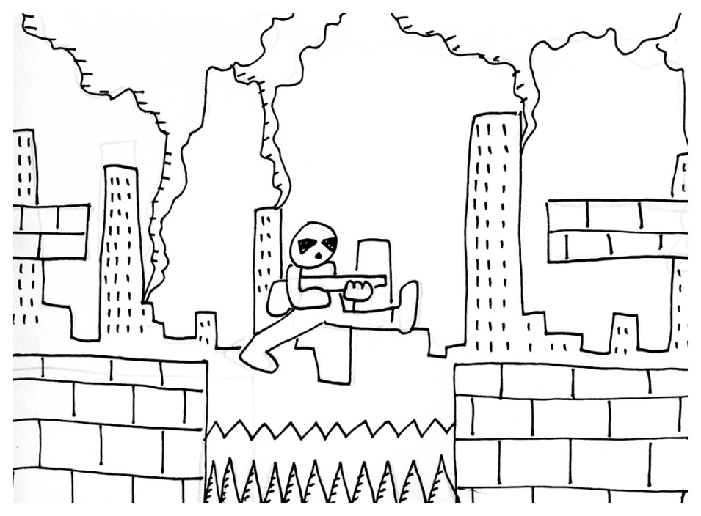
Concept Art

Slide 16
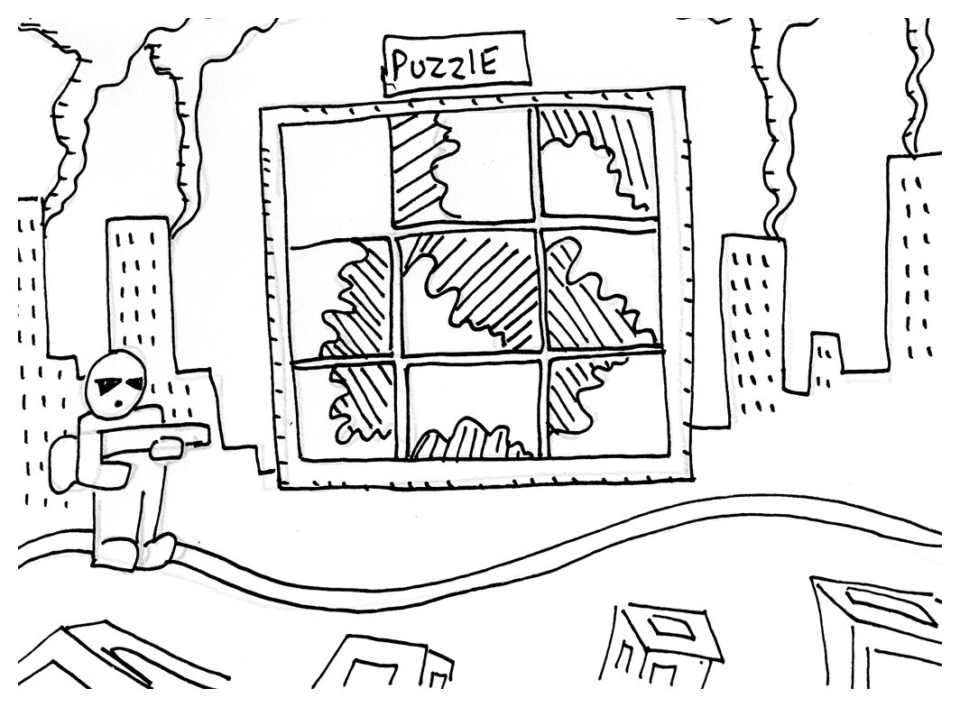
Concept Art

Slide 17
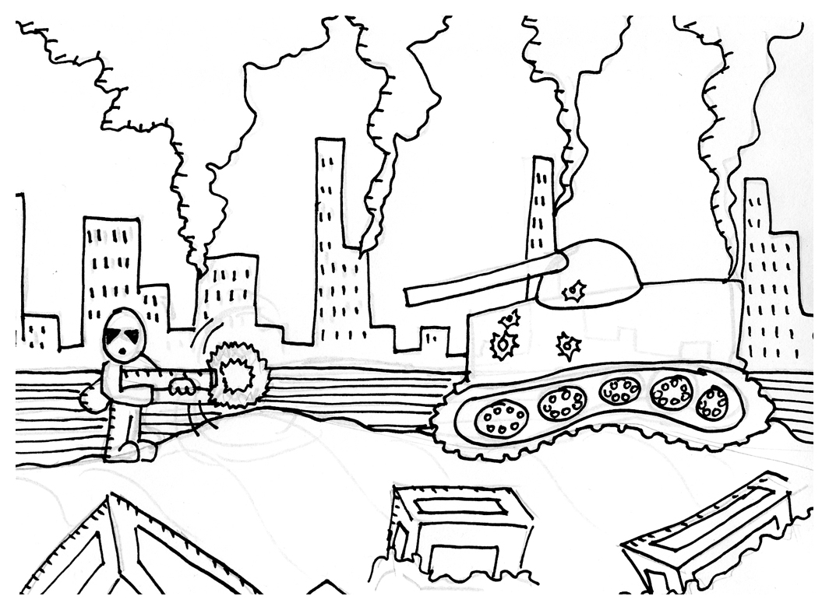
Concept Art

Slide 18
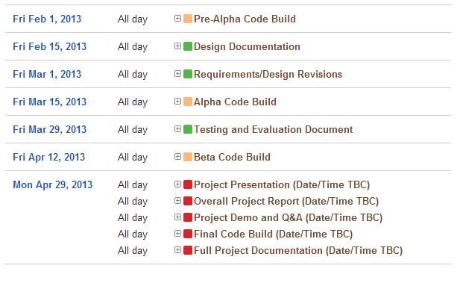
Implementation Plan
Available Hours
 | Mon | Tue | Wed | Thu | Fri | Sat | Sun | Total
Max | 5 | 5 | 7 | 5 | 6 | 4 | 10 | 42
Safe | 3 | 3 | 4 | 3 | 4 | 0 | 6 | 23
Overflow | 2 | 2 | 3 | 2 | 2 | 4 | 4 | 19

Slide 19
Conclusion
Lessons learned:
- Professional perspective is hard to find
- Use science to create a better game
- The Importance of feedback
Explored the domain
Minimised risk due to preparedness

